Slide 1
Introduction to Programming
Problem Solving using Computer Programs

Slide 2
Computer Programming History
Originally created to automate complex and tedious mathematical tasks:
  Code Breaking;
  Calculating navigation and mathematical tables;
First programs were written by mathematicians.
Later, scientists and engineers started writing their own programs.
In both cases, programs were written to
solve problems faster than humans could.
  C was written for the Unix (and Linux) operating systems
    very fast;
    works with memory directly;
    minimal checks and balances;
    written for experienced programmers!

Slide 3
Problem Solving
To write a useful program, you must have a clear understanding of:
  What the problem is;
  How to solve it;
  How to test the solution so that you know you’ve solved it.

Slide 4
Problem Solving
Once you have devised a way of solving the problem, you need to teach a computer to follow your method.
–That’s the programming part.

Slide 5
Problem Solving--computer style
A computer needs two different systems to find a solution:
Hardware
  A machine which can accept data, calculate results and the output the results in a form you can understand.
Software
  A computer program – a set of instructions written in a language understood by both the programmer and the computer.

Slide 6
Software
Source code written in one of many programming languages: Pascal, C, C++, BASIC, Java, etc.
Compiled – the “source code” is fed into a compiler which converts the source code into machine code.
Understood by the CPU

Slide 7
Software -> hardware
The compiled code (machine code) is linked with other pre-compiled machine code and is stored on the hard disk in an .exe file.
When you “run” the .exe file, the machine code is fed into the CPU, which then follows it’s coded instructions.

Slide 8
C Program Phases
Editing–source code (filename.c)
Compilation-object file (filename.o)
Linking-executable file (filename.exe)
Execution (run the file)
Editor
Preprocessor
Disk
Compiler
Linker
Loader
CPU
Memory

Slide 9
Running a program
The CPU
  gets input from the computer’s input devices (keyboard, files on the hard disk)
  sends results to the computer’s output devices (screen, files on the hard disk).
The program may
  Use data stored in the program (hard-coded),
  wait for input from the user---keyboard, or
  it might just use input stored in a file.

Slide 10
Program end
Your program ends when it runs out of instructions to perform.
It returns a number to the operating system (usually 0) to indicate that it performed correctly.
On a single-user computer, you get the C:> prompt back again. – control returned to the operating system.

Slide 11

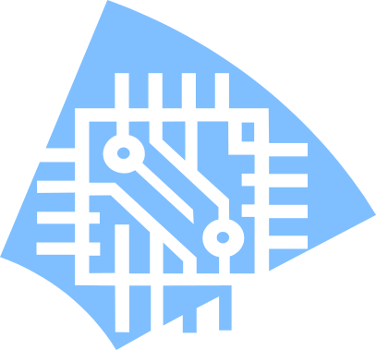

How it Works
User runs .exe
2. exe loaded into CPU
3.
CPU reads data, calculates, outputs results
Notes:
Introduction to Programming

Slide 12
Programming Live
We will now produce some simple programs in the lecture and explore what happens during the programming cycle.
  (The next few slides sum up the live demonstration in the lecture).
We edit, compile, debug, link and test programs:

Slide 13
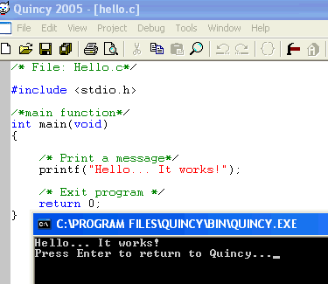
The simplest program…

Slide 14
What are the bits?
comment (ignored by computer)
preprocessor directive (allows program to do I/O)

Slide 15
What are the bits?
main function (run by OS)
function call (sends text to screen)

Slide 16
What are the bits?
end of function (sends 0 to OS)
output (screen-shot of DOS window)

Slide 17
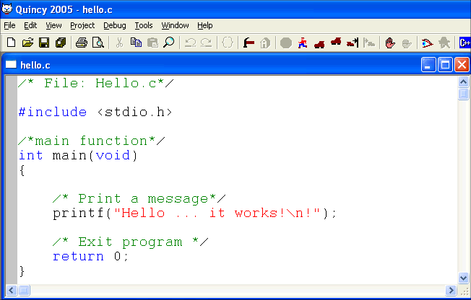
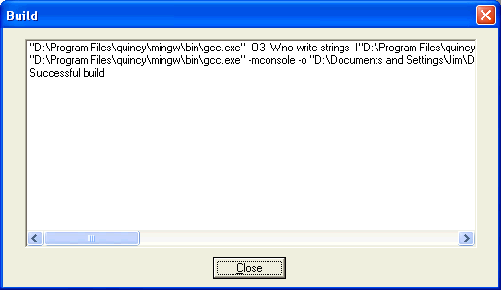
Compiling…
Click here to compile and link (build)
No syntax errors.

Slide 18
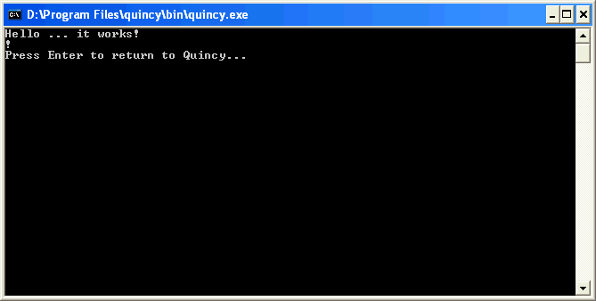
Running…
Click here to Run
DOS window opens up (may be hidden in Taskbar).
Don't close the window. Press Enter!

Slide 19
What goes wrong
Mistakes can occur in many parts of the process:
  Compilation (Syntax) errors – source code is impossible to convert to machine code.
  Run-time errors – program compiles correctly but may crash when run.
  Logical errors – program runs
  but calculates answers that
  are wrong.
Spelling,
Grammar
May not be detected until after the software is in use.

Slide 20
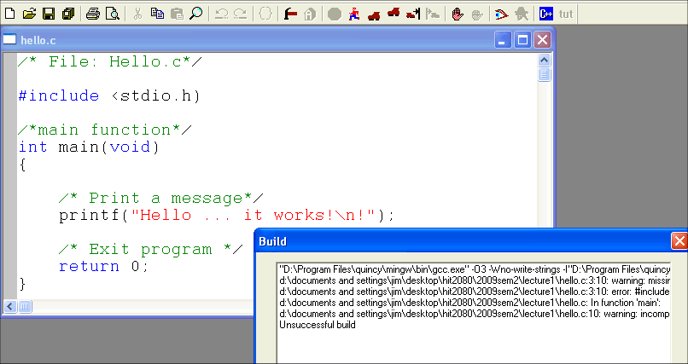
Syntax error
This is the problem: wrong type of bracket.
Line number of the first error
Error details (READ it!)

Slide 21
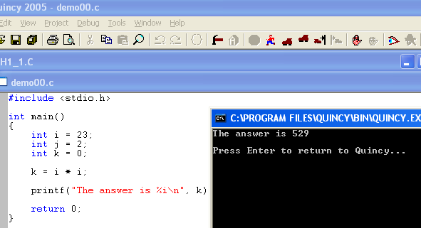
Logical errors
Some errors have nothing to do with the program – the programmer messes up the calculation.
The answer is wrong because this should be j.

Slide 22
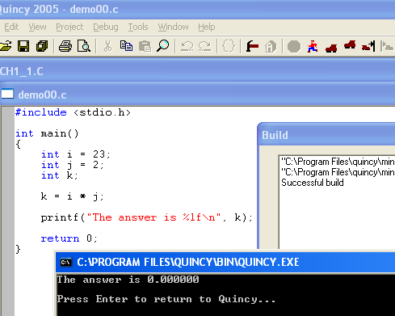
Run-time error
Program compiles correctly and runs correctly.
But the answer is horribly wrong.
This is the problem: wrong data type.

Slide 23
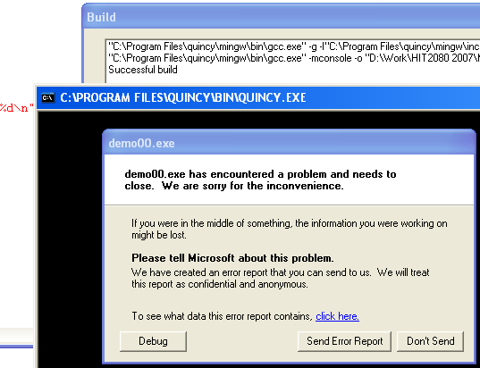
Run-time error
Some run-time errors crash the program (and sometimes Quincy).
The operating system (Windows) detects this and stops the program.
Click here if this happens.

Slide 24
Comments
You should always add comments to your programs.
Start with a comment block explaining what the program file name is, then what it does and who the author is.
Also add the date and time you last worked on the file
  This will help you keep track of which is the latest copy
e.g.
/*FILE: myProgram.c
* This program <does something>
* Author: A. Student, 1234567
* Last Modified: 10/07/2009 5:41pm
*/

Slide 25
Summary
Computers are fast but only follows instructions– you have to know how to solve a problem in order to write a program to solve it.
Logical and run-time errors mean that you need to check the output of the program to verify that it works correctly.
Writing a program: edit, save, (compile, link) or (build), run, TEST, repeat.
Syntax errors – fix the first one first.
Run-time errors – check data types and memory use.
Logical errors – compare with your own solution.

